Slide 1
Take a look at our Guest House

Slide 2
Introduction We have a small guest house where people can come to make a private retreat, an individually directed retreat or just to be quiet, rest and relax.

Slide 3
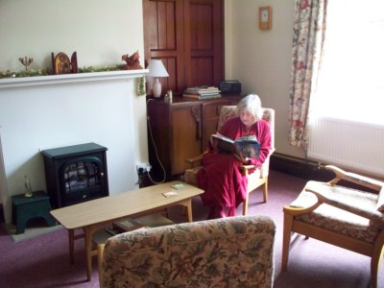
Our sitting room

Slide 4
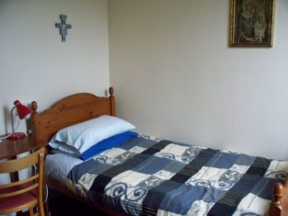
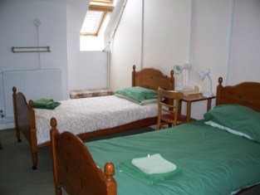
The rooms are small and simple but friendly and comfortable.

Slide 5
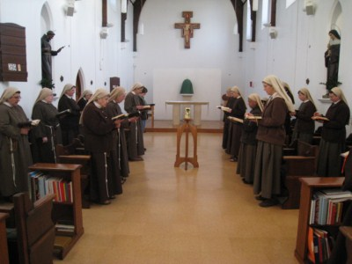
Guests are welcome to join the community for Mass and the Divine Office and to use the chapel at any time for private prayer

Slide 6
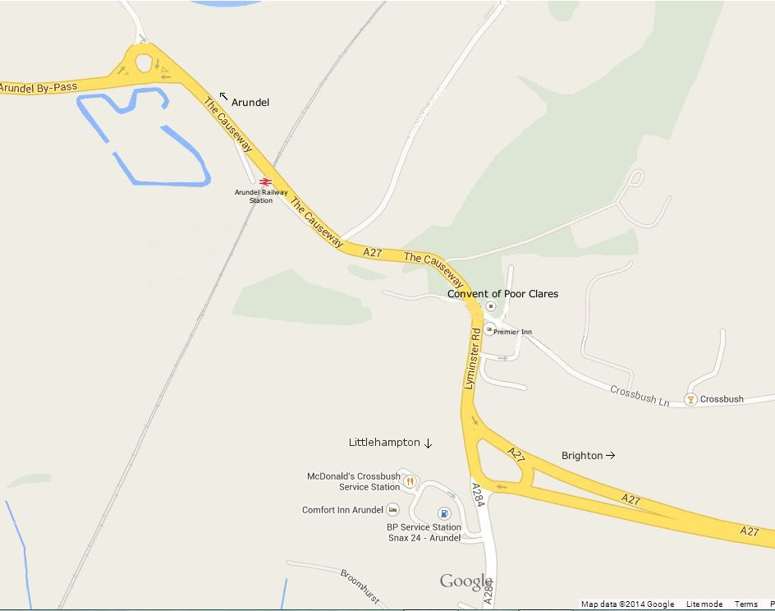
We are situated just off the A27, a mile east of Arundel, 10 minutes’ walk from the station.

Slide 7
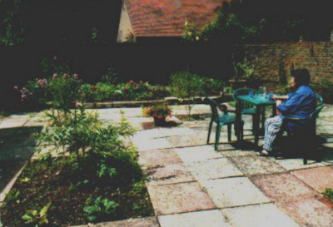
There are two small patio gardens and a little woodland area where guests can sit.

Slide 8
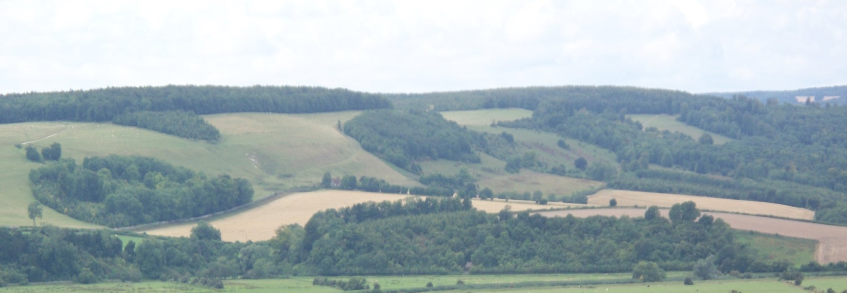
The surrounding countryside is beautiful as we are situated near the South Downs.

Slide 9
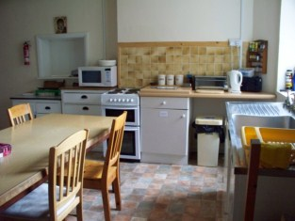
There are facilities for a self-service breakfast and supper, in a well-stocked kitchen; lunch is provided from the community kitchen.

Slide 10
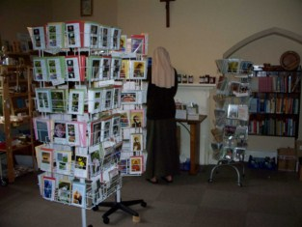
We also have a small shop where among other things we sell items we have made.

Slide 11
Thank you for joining us on this tour. If you would like to know more, write to our guest mistress, at Convent of Poor Clares, Crossbush, Arundel West Sussex BN18 9PJ poorclaresguesthouse@gmail.com

